Slide 1
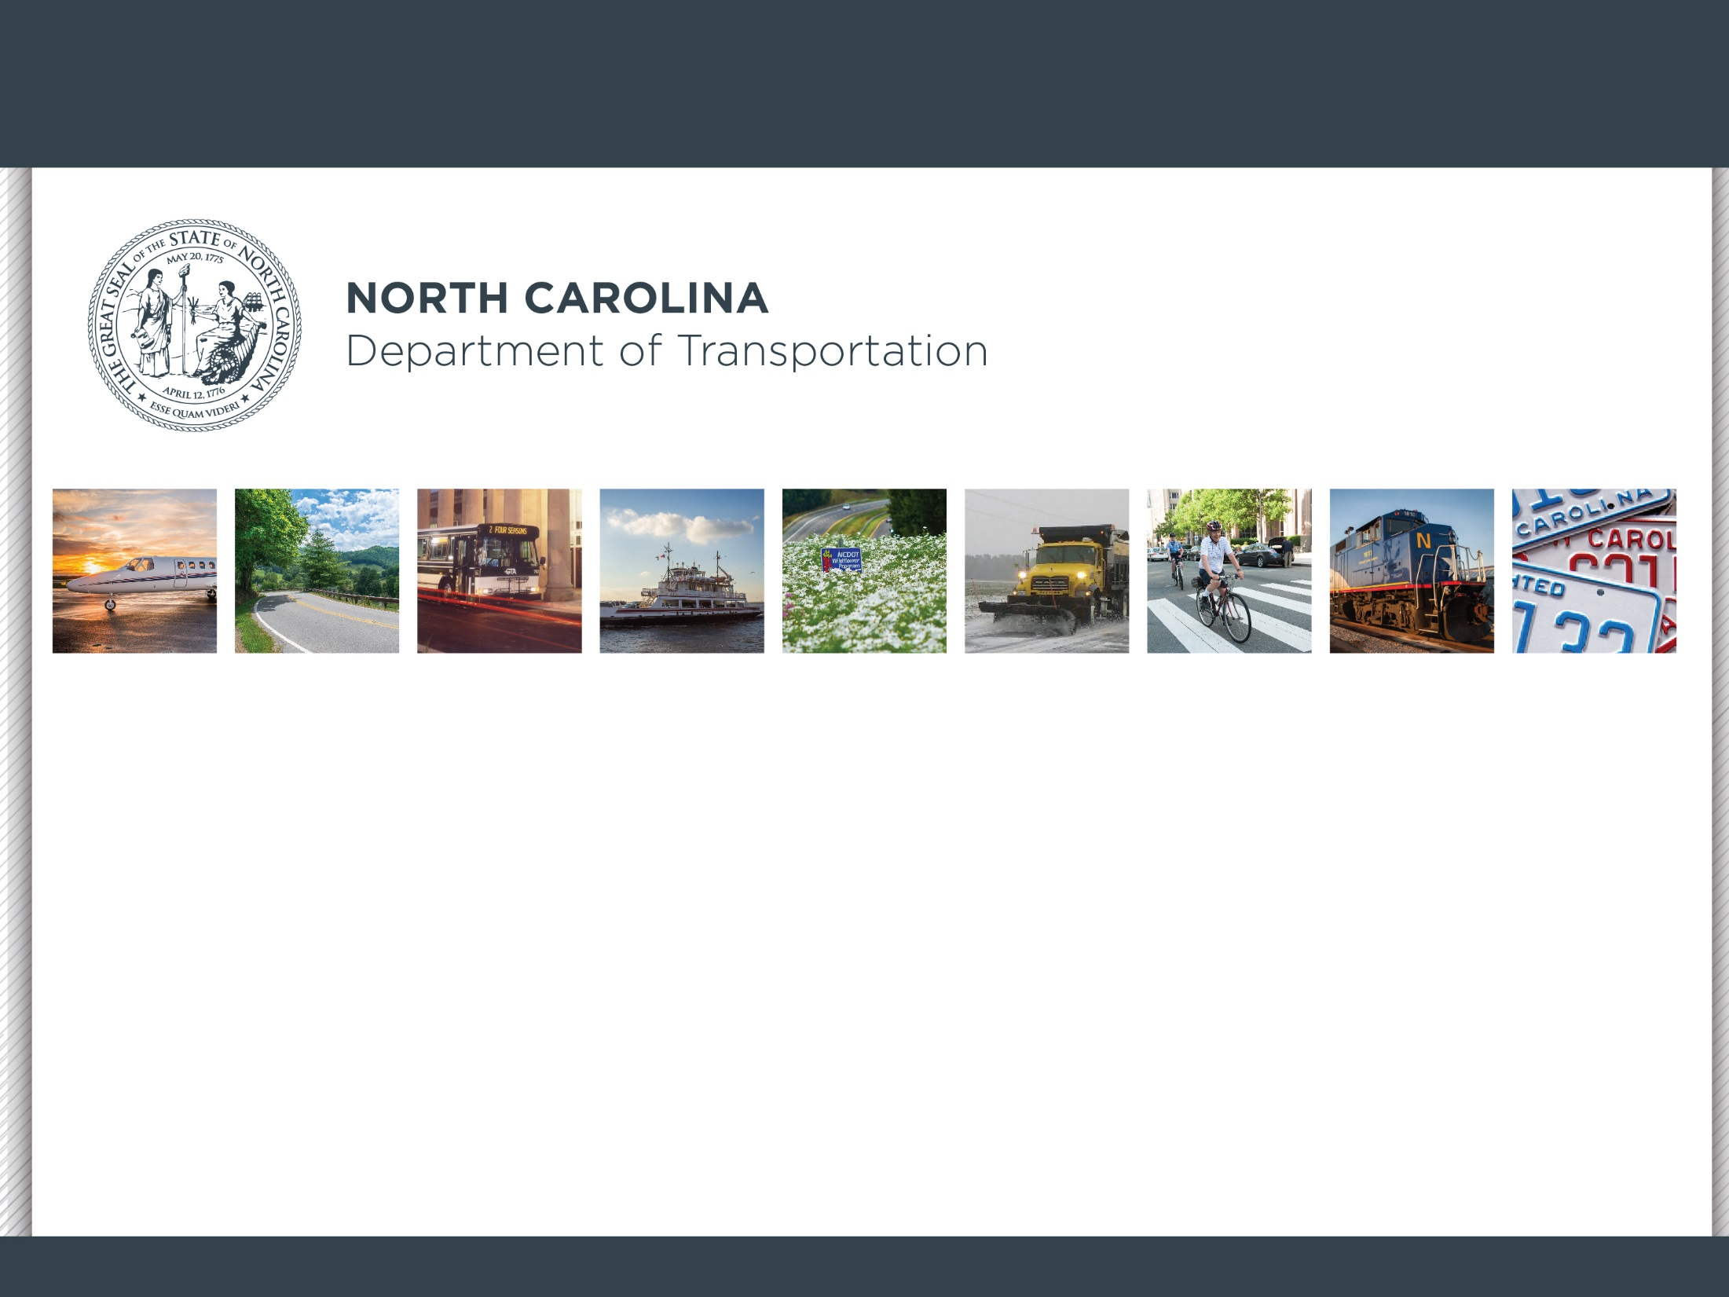
Prioritization Explained
Caitlin Marks, PE - Division Planning Engineer
May 1, 2019

Slide 2
HOW DO I GET A PROJECT FUNDED?
2
PRIORTIZATION – 2 Year Cycle !

Slide 3
PROJECT SUBMITTALS
P6.0
2
July 2019 – September 2019
CFRPO - 19 Submission Per Mode

Slide 4
Submittals - 6 Types of Projects
P6.0
Highway
Aviation
Public Transp.
MODES
Rail
Bike/Ped
Ferry

Slide 5
SCORING
P6.0
2
October 2019 – March 2020

Slide 6
STI Law Eligibility Definitions
Mode | Statewide Mobility
Highway | Interstates (existing & future) NHS routes (July 1, 2012) STRAHNET ADHS Routes Uncompleted Intrastate projects Designated Toll Facilities
Aviation | Large Commercial Service Airports ($500K cap)
Bicycle-Pedestrian | N/A
Public Transportation | N/A
Ferry | N/A
Rail | Freight Service on Class I Railroad Corridors
Regional Impact
Other US and NC Routes
Other Commercial Service Airports not in Statewide ($300K cap)
N/A
Service spanning two or more counties (10% cap)
Vessel or infrastructure expansion
Rail service spanning two or more counties not in Statewide
Division Needs
All County (SR) Routes Federal-Aid Eligible Local Roads
All Airports without Commercial Service (General Aviation) ($18.5M cap)
All projects ($0 state funds)
All other service, including terminals and stations
Replacement vessels
All other service, including terminals and stations (no short lines)

Slide 7
P5.0
P5.0 Quantitative Criteria
Funding Category | Highway | Bike/Ped | Rail
Statewide Mobility | Congestion Benefit-Cost Freight Safety Economic Competitiveness | N/A | Benefit-Cost Safety System Opportunities Capacity Economic competitiveness
Regional Impact | Congestion Benefit-Cost Safety Accessibility/Connectivity Freight |  | N/A | Benefit-Cost Safety System Opportunities Capacity Economic Competitiveness
Division Needs | Congestion Benefit-Cost Safety Accessibility/Connectivity Freight | Safety Access Demand/Density Connectivity Cost Effectiveness | System Opportunities Safety Benefit-Cost Capacity Economic Competitiveness

Slide 8
STATEWIDE MOBILITY Results & Programmed Released
P6.0
2
April 2020
Statewide Highest Score: 99.64 (D10 Aviation Project)
Statewide Lowest Programmed Score: 74.60

Slide 9
REGIONAL IMPACT Points Assigned
P6.0
2
May 2020 – July 2020
CFRPO – 1,300 points
Ex: 45.91 + (.15)*100 + (.15)*100 = 75.91
CFRPO
Points
NCDOT
Points

Slide 10
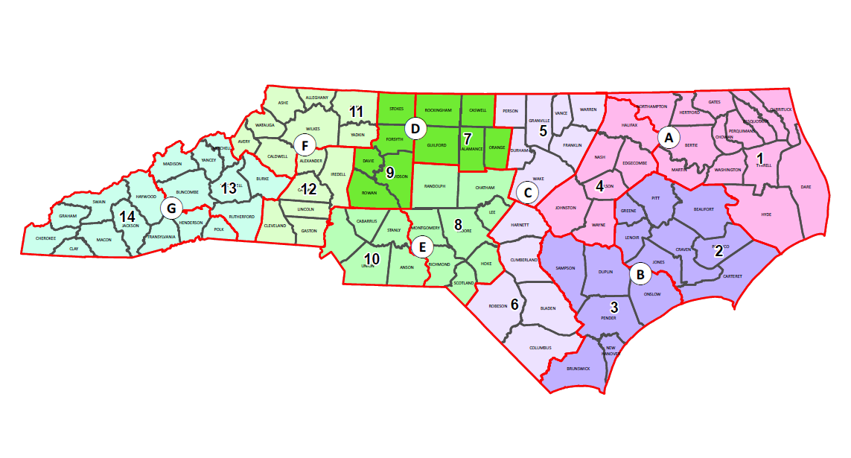
STI Prioritization and Programming Process
regions &
divisions
Notes:
2 Highway Divisions make up a Funding Region

Slide 11
REGIONAL IMPACT Results Released
P6.0
2
August 2020

Slide 12
DIVISION NEEDS Points Assigned
P6.0
2
September - October 2020
CFRPO – 1,300 points
Ex: 32.39 + (.25)*100 + (.25)*100 = 82.39
CFRPO
Points
NCDOT
Points

Slide 13
DIVISION NEEDS Results Released
P6.0
2
December 2020

Slide 14
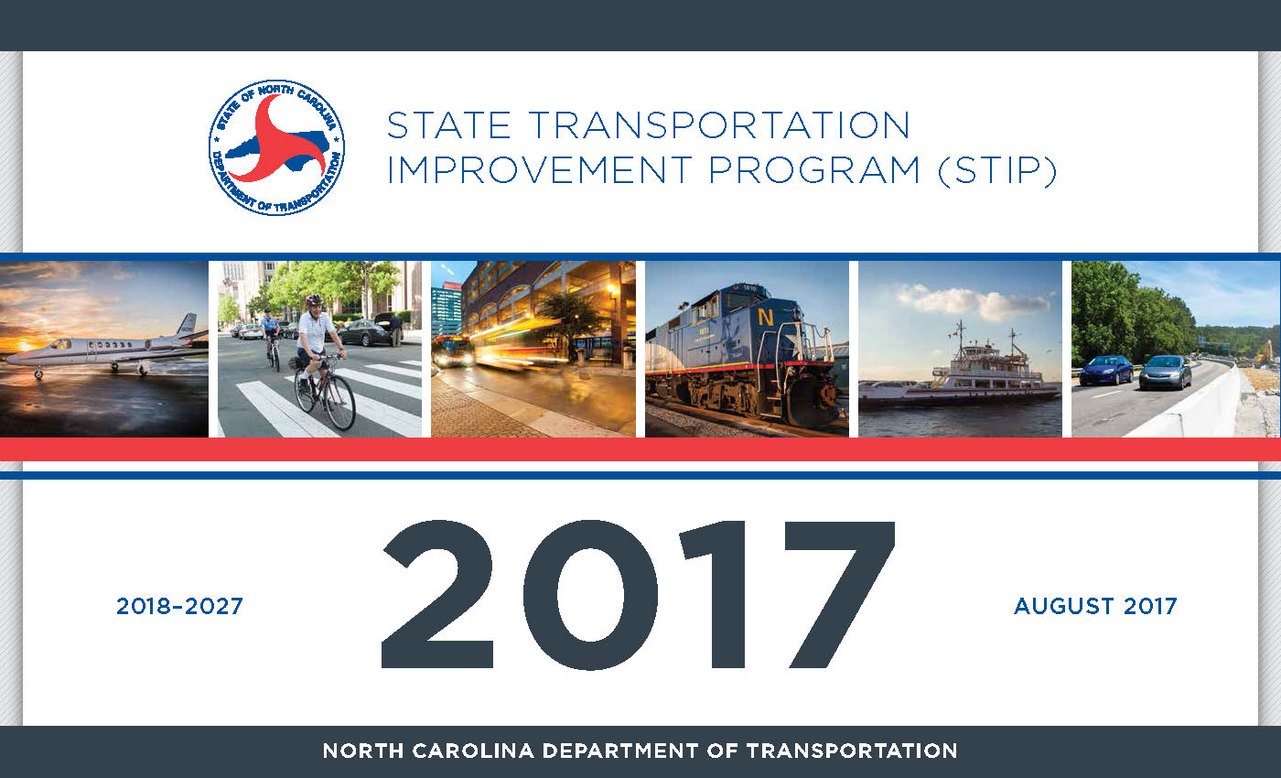
DRAFT STIP RELEASED
P6.0
2
January 2021
1
2021
2022-2031
July 2021

Slide 15
QUESTIONS?
2
Caitlin Marks – Division 3 Planning Engineer
cmmarks@ncdot.gov
910-341-2050

